Slide 1
Army OPORD Brief on ambush
Student’s Name
Institution

Slide 2
Introduction
Operation order (OPORD) refers to a directive that a leader gives to his junior leaders to ensure that there is a coordinated performance of a given order.
An ambush refers is a surprise attack using fire or any other destructive means from a concealed position upon a temporarily or moving enemy target.
Ambushes use surprise as a paramount tool and is launched at a place or time that the enemy is not prepared.
An ambush is basically launched to destroy the troops of the enemy as well as their equipment, which reduces the combat effectiveness of the enemy.

Slide 3
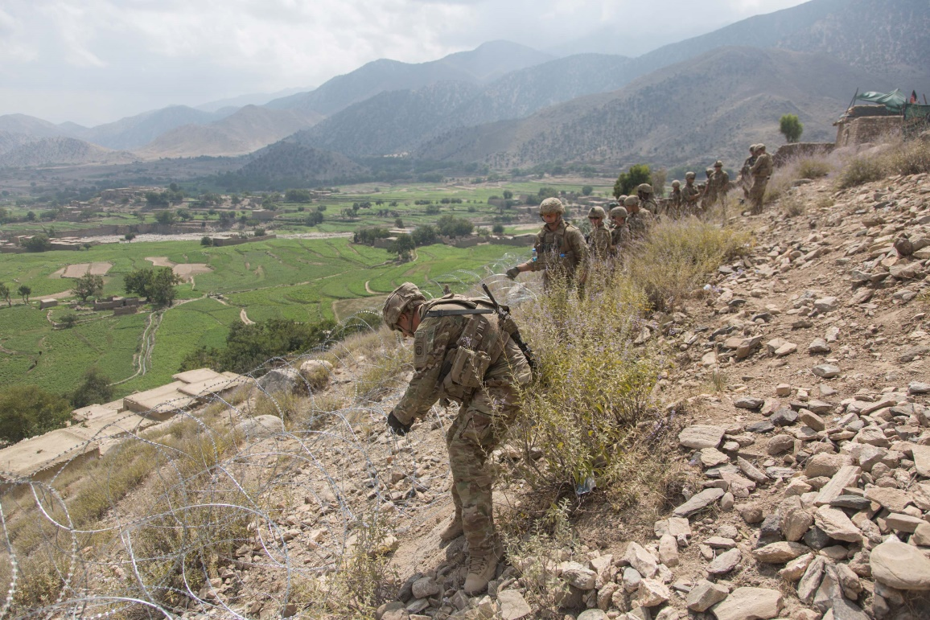
Situation: The Terrain Analysis
Terrain- Terrain defines the area of operations well as area of interest, advantages disadvantages to both friendly and enemy forces. They are abbreviated AOKOC:
  Avenues of approach
  Observation and field of fire
  Key terrain
  Obstacles
  Cover and Concealment
Terrain can have such features as hill, ridge, valley, Saddle and depression.

Slide 4
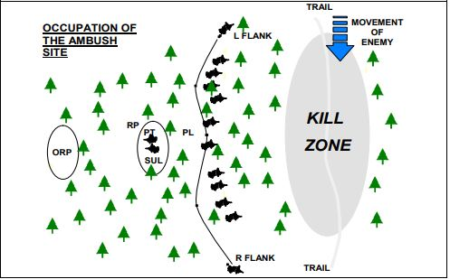
The Situation: The Terrain Analysis
Avenues of approach- For example, hills and valleys conceal the movement of troops. However, they provide good hiding places.
Observation and field of fire- Determine the locations that can provide good view points or allow covering the terrain with direct fire.
Key Terrain- This is the location that offers a marked advantage to both combatant in terms of control, seizure and retention.
Obstacles- It is important t determine all the existing obstacles within the terrain that may hinder movement.
Cover and concealment- involves determining weapon positions, locations for camouflaging to provide cover and concealment

Slide 5
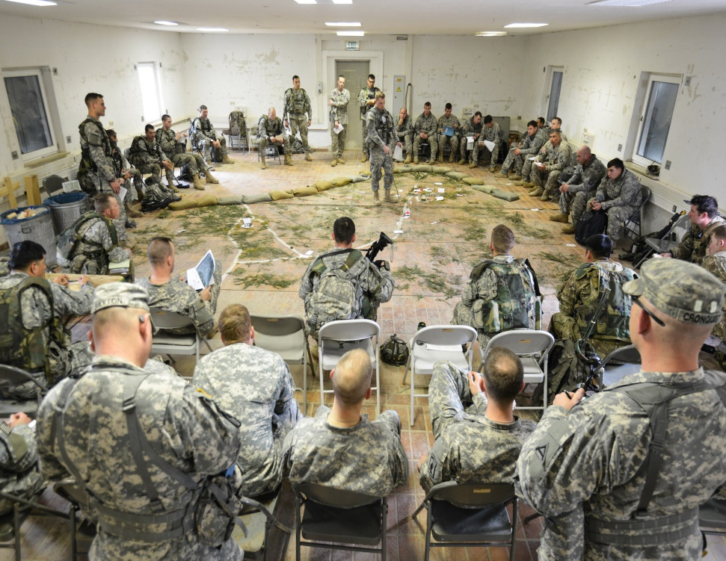
Ambush information
Types of Ambush
Deliberate ambush- it is planned in details and launched at a specific location
Ambush of opportunity- It is planned and prepared for. However, the information of the specific location to launch the ambush is not given.
Hasty ambush- The army prepares and rehearses but the ambush is launched without being detected. It is launched when the patrol leader sees an enemy force.

Slide 6
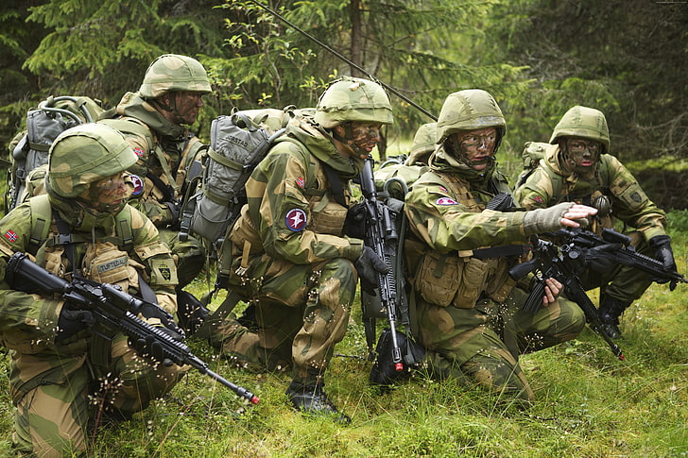
Planning for ambush
There is a great need for a detailed planning for an ambush.
Patrol leader must understand the patrol’s mission and the commander’s intent so as to start ambush planning.
For instance, a deliberate ambush will highly rely on the information about the enemy and the terrain use.

Slide 7
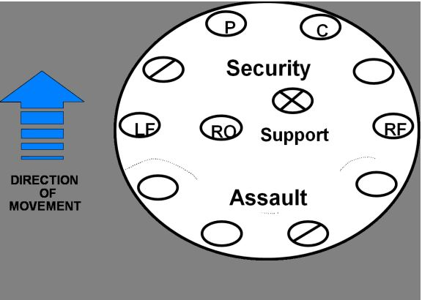
Planning for ambush: Task Organization
Personal Considerations
An ambush patrol is expected to follow a task organization of security unit, assault unit and support unit

Slide 8
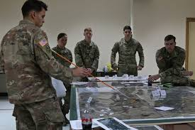
Task Organization (Cont)
Support Unit
The patrol designates a supporting effort
Provides security during movements towards or from the objective
May carry out Aid and liter team duties
May carry out Enemy prisoner of war duties
Isolates ambush position

Slide 9
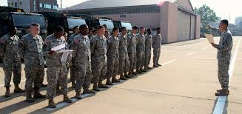
Task Organization (Cont)
Support Unit
It is a designated supporting effort.
May include patrol leader and assistant patrol leader.
Responsible for navigating to and from ambush site
Likely to initiate ambush.

Slide 10
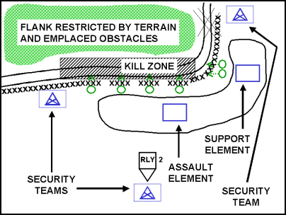
Task Organization (Cont)
Assault Unit
Likely designated the Main Effort (ME).
Responsible for 1/2 of the kill zone. –
Responsible for actions on the objective.
Responsible for sweeping the Kill Zone.
Responsible for searching the Kill Zone.
May fulfill EPW Team duties.
May fulfill Aid & Litter Team duties.

Slide 11
Task Organization:
Attachments- Considering the type of enemy that the ambush patrol plans to attack, the patrol leader has to utilize attachments to provide a supported unit to the ambushing squad.
Ambush locations- When choosing ambush locations, the patrol leader utilizes aerial photos, personal reconnaissance,
maps, and satellite imagery.
Time Consideration- Time can have various impacts on ambush patrol. How time is utilized can either reduce or create friction. For instance, requiring troops to return to friendly lines at a given time.

Slide 12
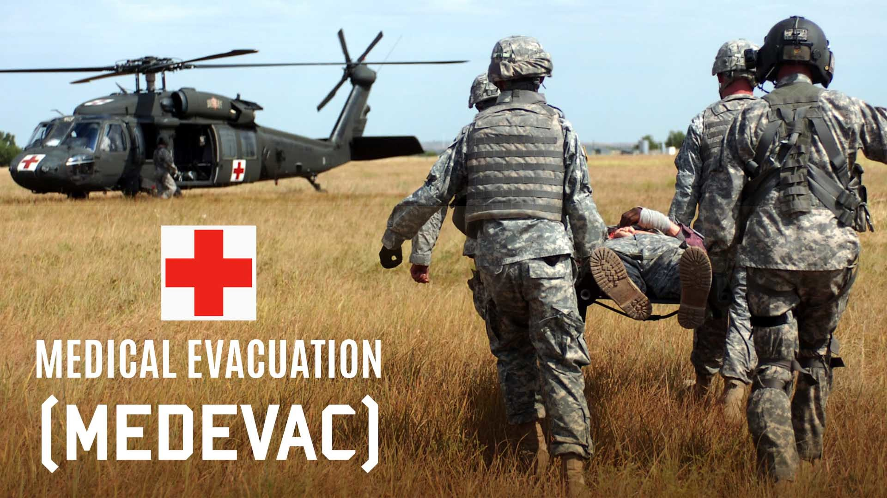
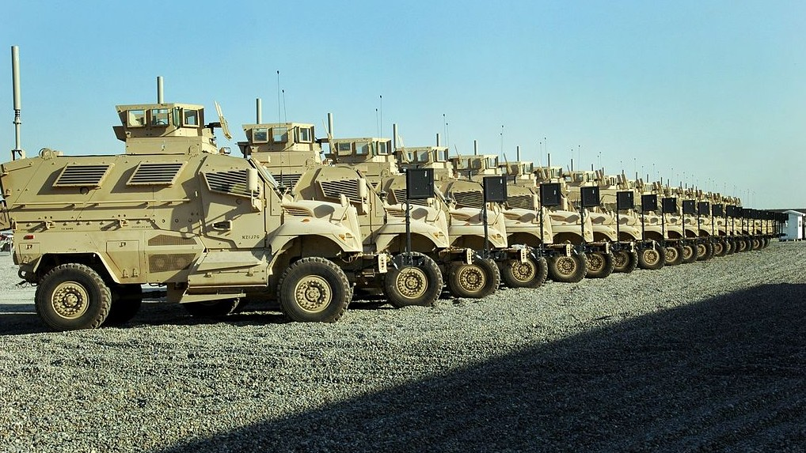
Planning for ambush: Equipment Considerations
Equipping the ambush patrol appropriately can determine the success or failure of the ambush.
The PL must choose the only equipment that is necessary for the ambush mission
Rehearsals on the usage of the equipment is very vital.
Gear and equipment must consider human factors and weather.
Examples of required items: utility uniform, flak jacket, FLC, red-lens flashlight,warming layers, weapons cleaning gear, water, food, etc

Slide 13
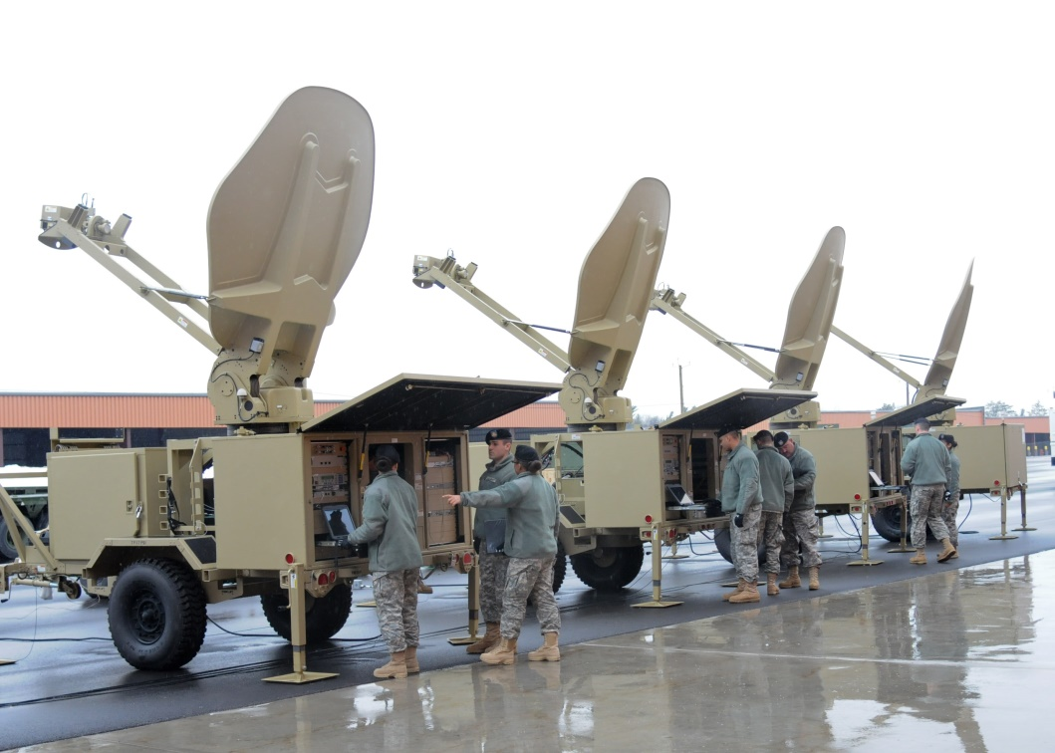
Equipment Considerations
Additional inorganic gear and equipment to assist in moving to and from objective area. E.g. carabineers, Swiss-seats, and safety lines night vision devices
Items that can heighten Command and Control. They may include Claymore mines, Site Exploitation kits and EPW kits.
Optical devices will enable the ambush patrol to better observations.
Non-traditional and inorganic communication devices will improve the PL’s command and control.

Slide 14
Conclusion
Having a detailed and a clear plan on how to conduct an ambush is key the success of a mission.
A good ambush should create disruption and disorganize he enemy’s scheme of movement
Patrol bases play an important ole for conducting constant patrolling operations.
Understanding how to launch a successful ambush helps creating havoc on the enemy.

